Slide 1
Surgical Weight Loss Institute Informational Seminar

Slide 2
Your Journey to Good Health Through Weight Loss Surgery

Slide 3
Presentation Outline
Accredited Bariatric Program
History & Trends in Obesity
Surgical Options
Food Choices
Cognitive Behavioral Therapy
Conclusion

Slide 4
Multidisciplinary Team
Bariatric Surgeons
Olympus Visera 4K Ultra High-Definition Imaging System & 3D Flex Scope
Bariatric Experienced Anesthesiologist
Trained OR staff, nurses and technicians
Bariatric Unit with dedicated and experienced nurses and staff
Psychiatrist / Social Workers
Nurse Practitioners
Nurse Educators
Registered Dietitians
Patient Navigators
Support Group Facilitators
Insurance Specialist

Slide 5
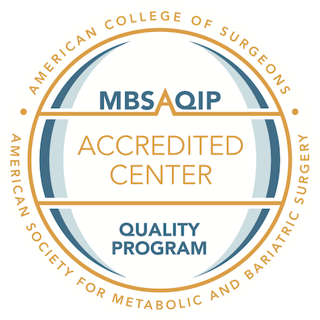
Combined respective national bariatric surgery accreditation programs into one unified program to achieve one national accreditation standard for bariatric surgery centers.

Slide 6
Defining Obesity
Weight Category | BMI (kg/m²)
Healthy Weight | 18.5-24.9
Overweight | 25-29.9
Obese (Class I) | 30-34.9
Severely Obese (Class II) | 35-39.9
Morbidly Obese (Class III) | ≥40
Body Mass Index (BMI)
Measures obesity based on
height and weight

Slide 7
Body Mass Index (BMI)
Used to measure obesity based on height & weight
One aspect to determine eligibility for surgery
Normal Weight (BMI* 18.5 to 24.9)
Overweight (BMI 25 to 29.9)
Obese (BMI 30 to 34.9)
Severely Obese (BMI 35 to 39.9 )
Morbidly Obese (BMI 40 or more)

Slide 8
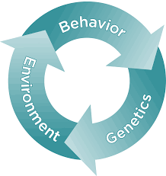
Obesity Causes
Obesity is a complex disease
It is caused by a variety of factors
Genes
Metabolism
Behavior
Environment
Culture
Socioeconomic status

Slide 9
Eligibility
Patients 18 years and above
Criteria
Covered by most insurances
BMI > 40
BMI > 35 with a health condition
BMI > 30 for adjustable gastric band
with a health condition such as:
Diabetes
Heart Disease
Sleep Apnea
High Cholesterol
High Blood Pressure

Slide 10
Obesity Statistics
Prevalence
Obesity rates vary by:
68.8 % of adults in the US are overweight or obese*
35.7 % of adults are considered to be obese*
Gender
Age
Ethnic background
State

Slide 11
Prevalence¶ of Self-Reported Obesity Among U.S. Adults by State and Territory, BRFSS, 2015

Slide 12
Type II Diabetes & Obesity
Nearly 90% of patients with newly diagnosed type 2 diabetes are overweight or obese.
The American Association of Clinical Endocrinologists have acknowledged that the beneficial effect of bariatric surgery on reversal of existing diabetes mellitus and prevention of its development has been confirmed in a number of studies.
Diabetes can lead to these other serious medical conditions:
Heart disease
Stroke
Hypertension
Blindness
Kidney disease
Nervous system disease
Amputations

Slide 13
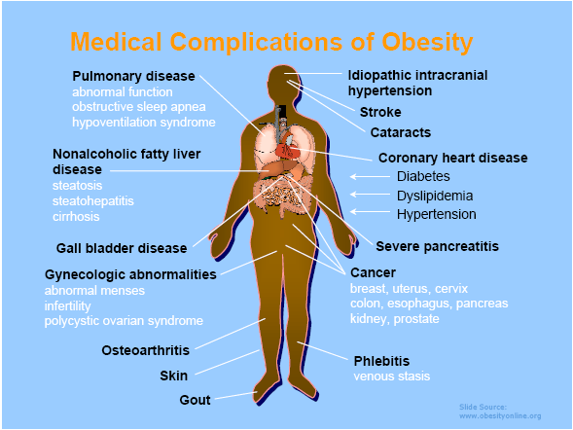

Slide 14
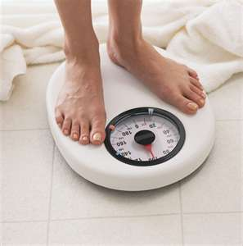
Weight Loss Approaches
Diet
Exercise
Behavioral Modifications
Pharmacotherapy
Bariatric Surgery

Slide 15
Bariatric surgery is a safe and the only effective treatment for obesity
We offer:
An in-depth approach to weight loss via a team of specialists
Guide the bariatric patient through a comprehensive process and pre-operative consultation
Weight loss surgery (Gastric Sleeve, RN-Y Gastric Bypass, or Lap Band)
Long-term follow-up, and ongoing support groups

Slide 16
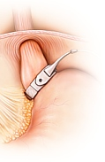
Surgical Options
Lapband
Sleeve Gastrectomy
Gastric Bypass

Slide 17
Food Choices
Proper nutrition will be key to success both before & after surgery
Start to practice making better food choices now to begin your weight loss journey
Begin to work 1:1 with our Registered Dietitian

Slide 18
Dietary Guidelines
Very Low Calorie Diet
Protein
Vital nutrient needed by all parts of the body
Promotes healing
Prevents excessive muscle loss & slowing metabolism
Fruits
Good source of fiber, vitamins, & minerals
Vegetables
Contain important vitamins & minerals
Good source of fiber
Nonstarchy vegetables are ideal
Water
Water or very low-calorie liquid (>5cal/serving)
64 oz or more per day is recommended

Slide 19
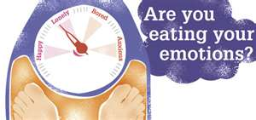
Lifestyle Changes
Cognitive Behavior Therapy (CBT)
Learn how to replace emotional eating
Lifestyle changes
Differentiate between physical / mental hunger
Inspiration
Set goals
Structure /Consistency
Pre-planning: food, exercise, support, reading labels
Journaling
Food/Emotions/Water/Exercise
Support System
Family/ Friends / Support Groups / Co-workers / Professional Staff

Slide 20
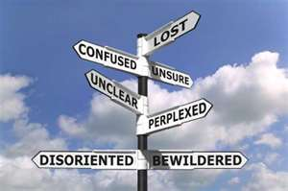
Emotional Impact
Weight loss does not eliminate everyday problems
learning how to cope without seeking food for comfort is necessary
Potential for transfer of addiction
Spending Money / Shopping
Drugs
Alcohol
Sex
Gambling
Counseling

Slide 21
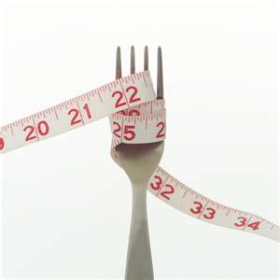
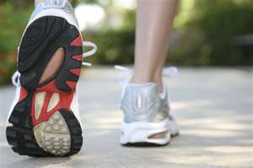
Long Term Weight Loss
Losing and maintaining weight after surgery is truly based on lifestyle changes for the long term success
Food choices
Exercise
Ongoing support
Follow-up care with bariatric program
Avoid Grazing (unnecessary snacking)
Overeating: risk of damaging size of stomach/ pouch / esophagus

Slide 22
Good Samaritan Hospital Bariatric Team

Slide 24
Bon Secours Community Hospital Bariatric Team

Slide 26
Thank you
For more information please contact us:
Good Samaritan Hospital 255 Lafayette Ave Suffern, NY 10901 Maria Scaffidi, MPA, RD, CDN - Bariatric Program Coordinator Phone: 845.368.5285 Fax: 845.368.5715
Bon Secours Community Hospital 160 East Main St Port Jervis, NY Cynthia Marsilio, RN, MSN, ANP - Bariatric Program Director Phone: 845.858.7277 Fax: 845.858.7279

